Slide 1
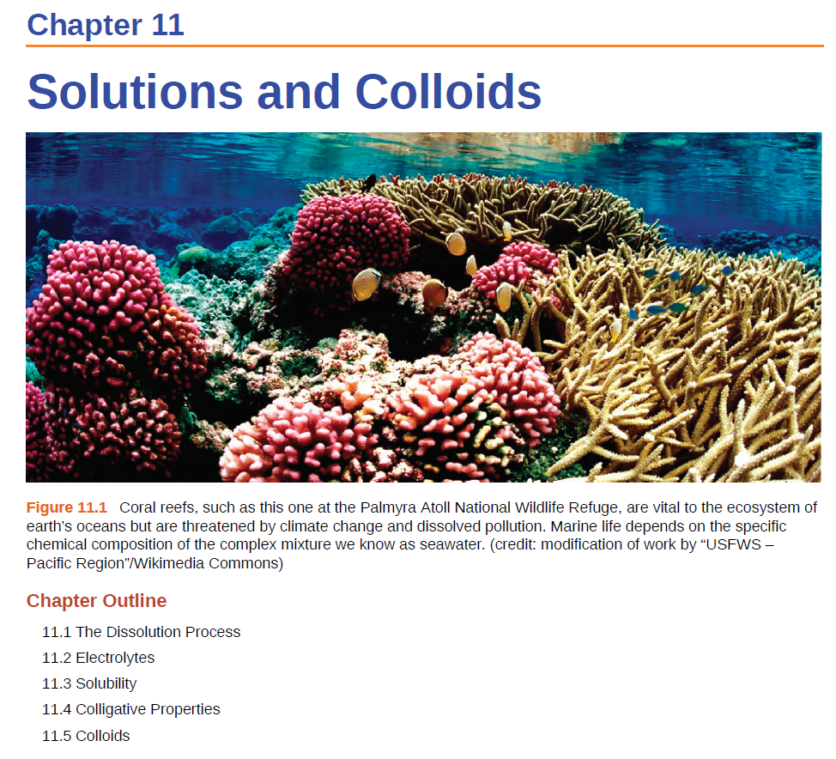


Slide 2
Colligative Properties of Solutions
Solution- a homogenous mixture of two or more substances.
Solubility- the maximum amount of a solute that will dissolve in a given quantity of solvent at a specific temperature.
When solute is introduced into the volume of solvent, the solvent properties change
Colligative properties are properties of solutions that depend solely on the number of particles dissolved in the solution
Four types of colligative properties of solutions:
0
Vapor-Pressure Lowering
P₁ = X₁ P ₁
Boiling-Point Elevation
ΔT_{b} = K_{b} m
Freezing-Point Depression
ΔT_{f} = K_{f} m
Osmotic Pressure (π)
π = MRT

Slide 3

Vapor-Pressure Lowering
Occurs with non-volatile, non-ionizing solutes at low solute concentrations.
~0 vapor pressure
does not dissociate
Larger entropy increase
Smaller entropy increase
disordered
disordered
strong driving force
Gas
weaker driving force
“Ordered”
Liquid
less “Ordered”
Solute molecule
The vapor pressure of a pure solvent drops whenever non-volatile solute is added.

Slide 4
Raoult’s Law (Vapor Pressure Lowering)
The vapor pressure (P₁ ) of a solvent is directly proportional to the mole fraction (X₁ ) of the solvent in the solution
Raoult’s Law:
P₁ = X₁ × P ⁰₁
(P ⁰₁ – vapor pressure of the pure solvent)
vapor pressure (P₁) ∝ mole fraction of solvent(X₁)
moles of solvent
For pure solvent X₁ = 1.0,
and
X₁ =
moles of solvent + moles of solute
P₁ = P ⁰₁
moles of solute
X₁
P₁
As solute is added, the vapor pressure drops.

Slide 5
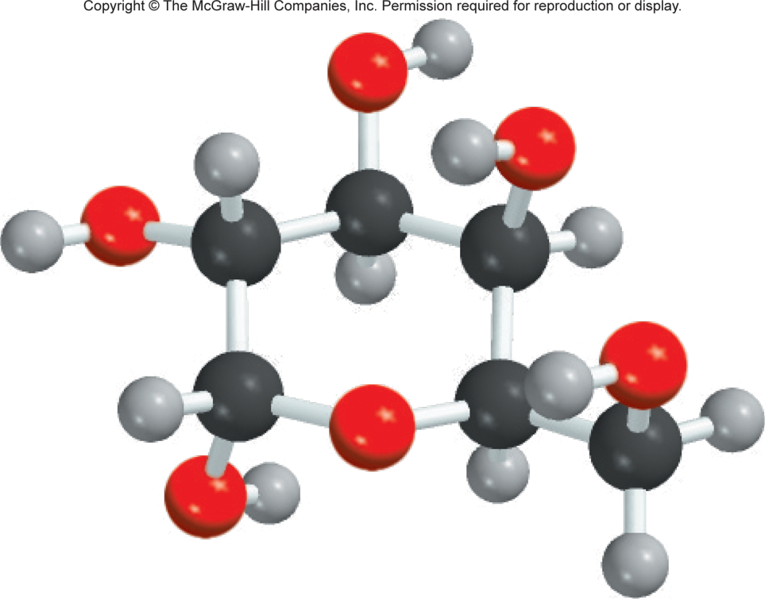
12.7
Calculate the vapor pressure of a solution made by dissolving 218 g of glucose (molar mass = 180.2 g/mol) in 460 mL of water at 30°C (P_{H2O} = 31.82 mmHg). Assume the density of the solvent is 1.00 g/mL.
What is the vapor-pressure lowering?
P₁ = X₁ × P ⁰₁
P⁰₁ = vapor pressure of pure solvent
P₁ = vapor pressure of the solution
X₁ = mole fraction of solvent

Slide 6
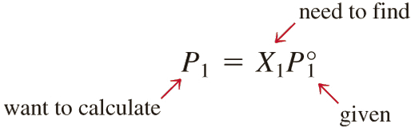
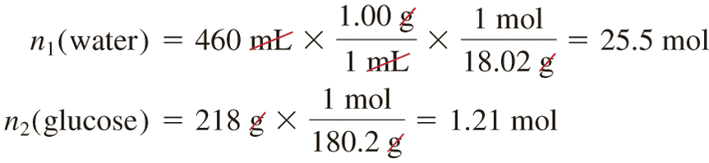
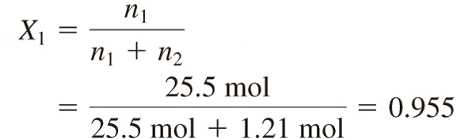
12.7
Solution The vapor pressure of a solution (P₁) is
First we calculate the number of moles of glucose and water in the solution:
The mole fraction of water, X₁, is given by

Slide 7
12.7
The vapor pressure of water at 30°C is31.82 mmHg. Therefore, the vapor pressure of the glucose solution is
Finally, the vapor-pressure lowering (ΔP) is
(31.82 − 30.4) mmHg, or 1.4 mmHg.
P₁ = 0.955 × 31.82 mmHg
= 30.4 mmHg

Slide 8
Vapor-Pressure Lowering
What about volatile solutes (solutes with a vapor pressure).
Example: Ethanol in water.
Gas
Liquid
Solute molecule
The vapor pressure = the sum of the vapor pressure of the components. The vapor pressure for the solvent is reduced.

Slide 9
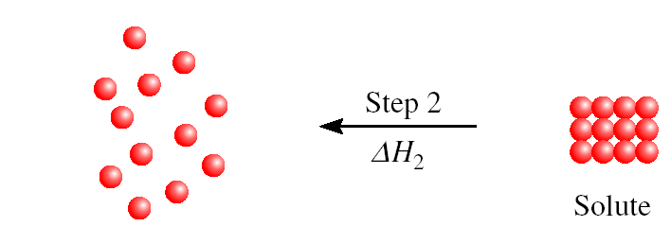
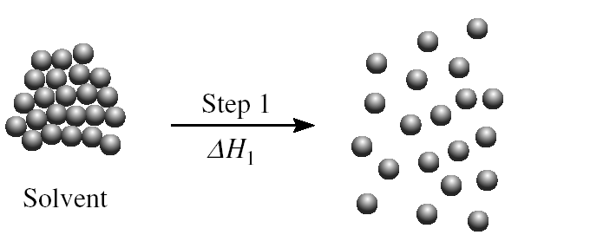
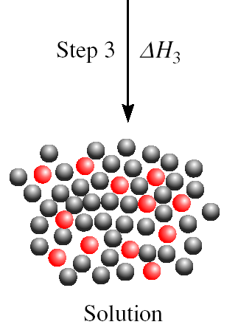
Raoult’s Law (Liquid-Liquid Mixture)
If components A and B of a solution are volatile,
Raoult’s law still holds:
P_{A} = X_{A}×P ⁰_{A}
P_{B} = X_{B}×P ⁰_{B}
P_{T} = P_{A} + P_{B}
P_{T} = X_{A}×P ⁰_{A} + X_{B}×P ⁰_{B}
Assuming it is an ideal solution
For an ideal solution, ΔH_{soln} = 0
B
A
ΔH_{soln} = ΔH₁ + ΔH₂ + ΔH₃
Ideal if:
solvent-solute interaction = solute-solute + solvent-solvent

Slide 10
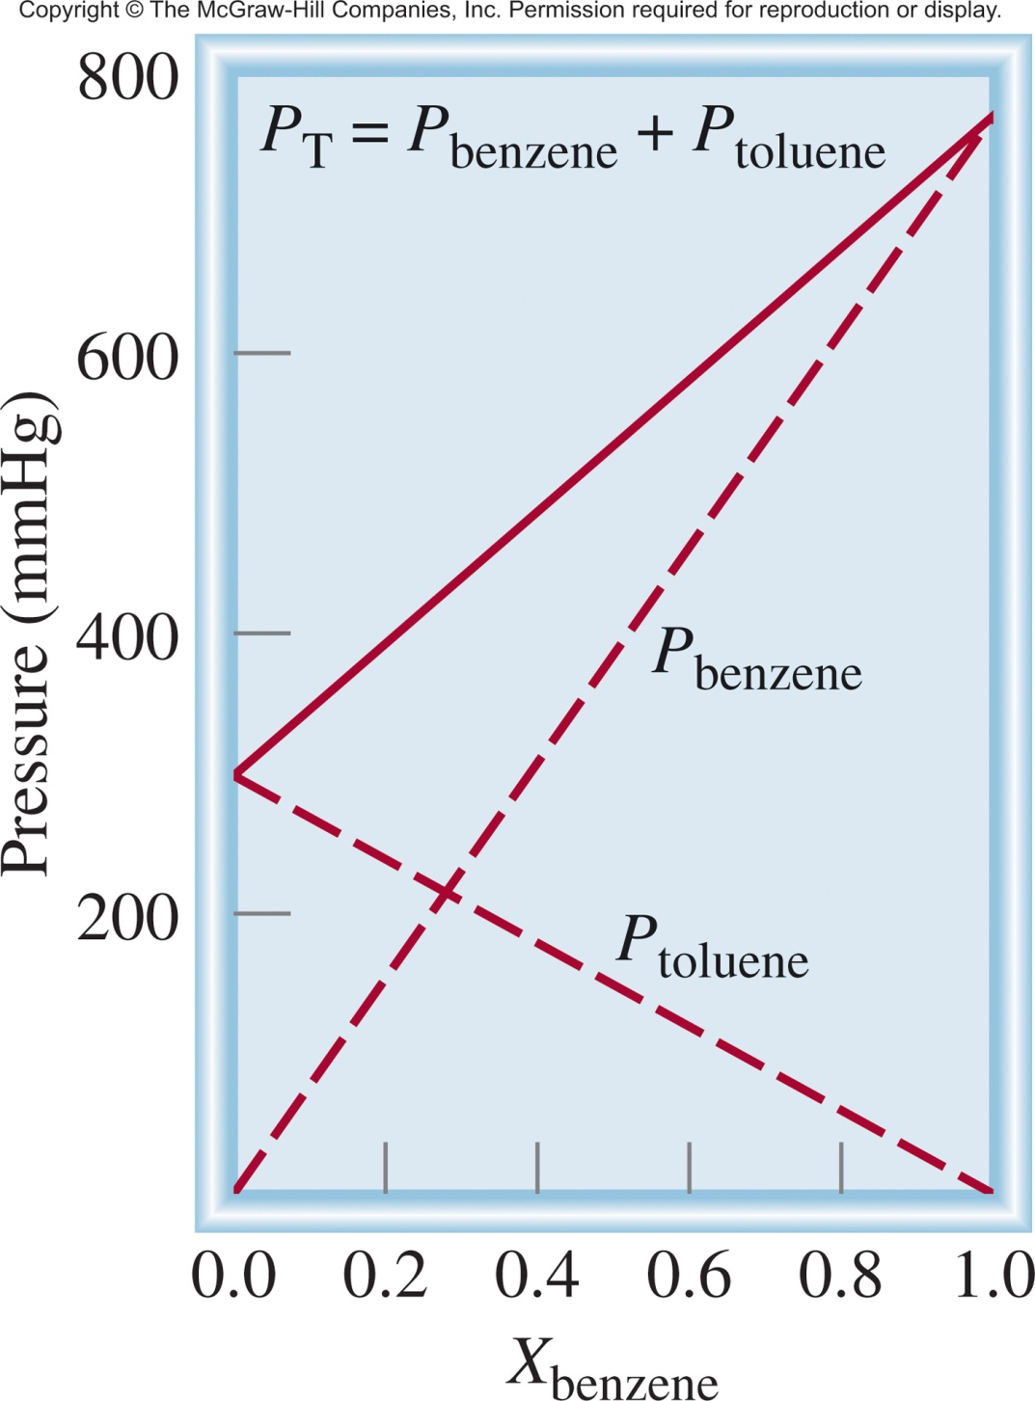
Raoult’s Law (Liquid-Liquid Mixture)
Benzene and toluene form an “ideal” solution
benzene (A)
toluene (B)
P_{A} = X_{A}×P ⁰_{A}
P_{B} = X_{B}×P ⁰_{B}
P_{T} = P_{A} + P_{B}
P_{T} = X_{A}×P ⁰_{A} + X_{B}×P ⁰_{B}
Benzene and toluene similar structures, similar forces (dispersion forces).
What about other liquid-liquid mixtures?

Slide 11
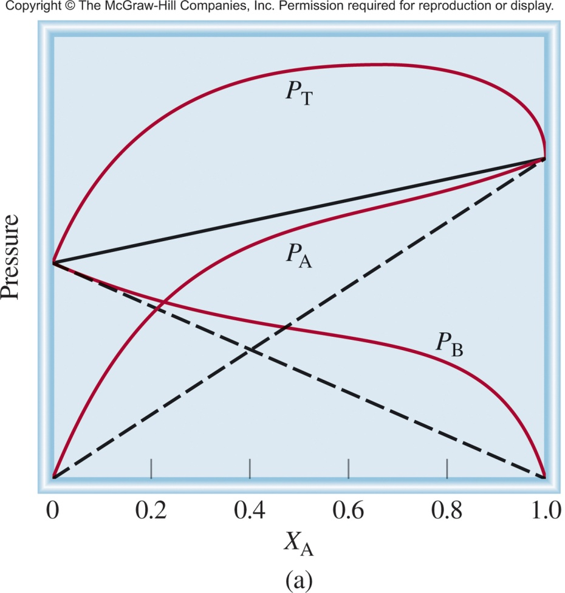
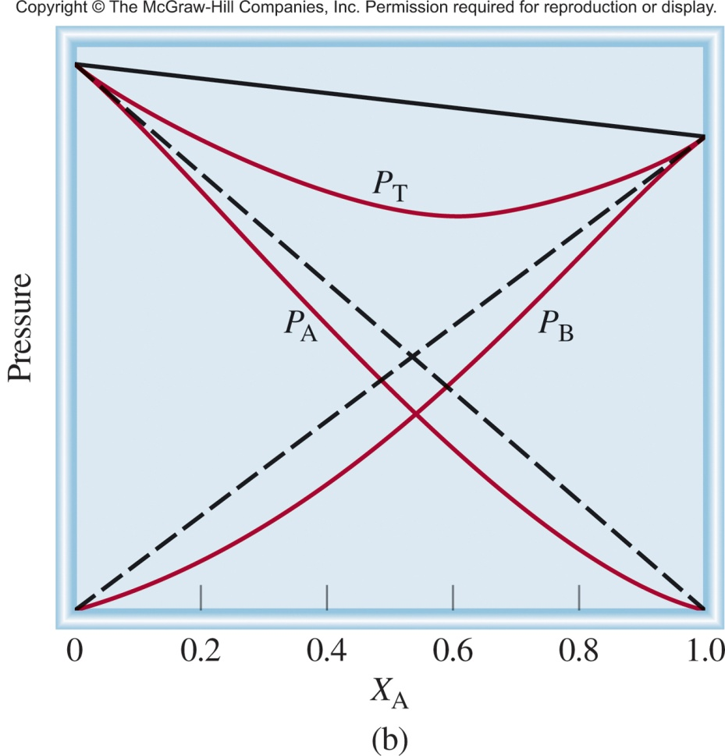
Raoult’s Law (Liquid-Liquid Mixture)
Most solutions are nonideal and deviate from Raoult’s law!
Positive Deviation
Negative Deviation
P_{A}, P_{B} and P_{T} are greater than predicted
P_{A}, P_{B} and P_{T} are smaller than predicted
Force
A-B
Force
A-A
Force
B-B
Force
A-B
Force
A-A
Force
B-B
<
+
>
+
A and B hate each other
and want to get out!
A and B like each other
and want to stay together!

Slide 12
Colligative Properties of Solutions
Solution- a homogenous mixture of two or more substances.
Solubility- the maximum amount of a solute that will dissolve in a given quantity of solvent at a specific temperature.
When solute is introduced into the volume of solvent, the solvent properties change
Colligative properties are properties of solutions that depend solely on the number of particles dissolved in the solution
Four types of colligative properties of solutions:
0
Vapor-Pressure Lowering
P₁ = X₁ P ₁
Boiling-Point Elevation
ΔT_{b} = K_{b} m
Freezing-Point Depression
ΔT_{f} = K_{f} m
Osmotic Pressure (π)
π = MRT

Slide 13
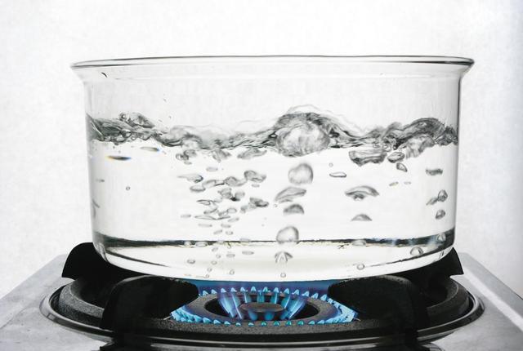
Fwd: From Grandma
Adding salt (non-volatile solute) to water (solvent) will:
make the water boil hotter.
reduce the time it takes to boil.
A) True
B) False
A) True
B) False

Slide 14
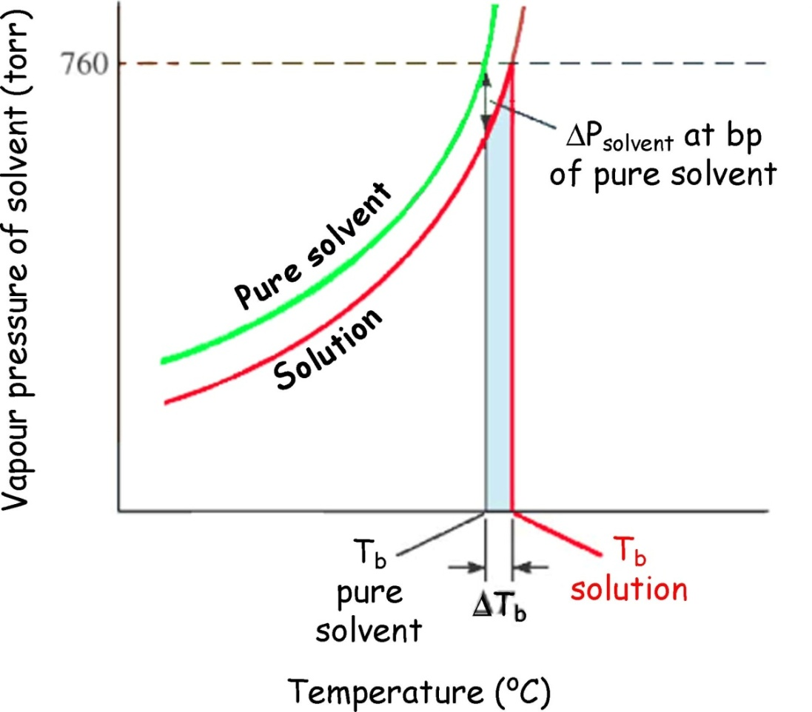
Solutions and Cooking
Adding salt (non-volatile solute) to water (solvent)
Raoult’s law:
P₁ = X₁ × P ⁰₁
P⁰₁ = vapor pressure of pure solvent
P₁ = vapor pressure of the solution
X₁ = mole fraction of solvent
moles of solute
X₁
P₁
Boiling Pt
As solute is added, the vapor pressure decreases, more energy (higher boiling point) is required for the vapor pressure to equal atmospheric pressure!
AKA Boiling Point Elevation.

Slide 15
Boiling Point Elevation
As expected from Raoult’s law, which predicts lower vapor pressure, boiling temperature elevation is determined by the number of moles of solute dissolved in the solution:
ΔT_{b} – the change in boiling point (°C)
m – molality of the solution (mol/kg)
K_{b} – boiling point elevation constant (°C/(mol/kg) or °C/m)
change in bp temperature (ΔT_{b}) ∝ molality of the solution (m)
ΔT_{b} = K_{b}m
Note: the K_{b} value only depends on the solvent
the molality, m depends on the concentration of solute

Slide 16
Fact Checking, Fwd: From Grandma
Adding salt (non-volatile solute) to water (solvent) will:
make the water boil hotter.
reduce the time it takes to boil.
A) True
B) False
A) True
B) False

Slide 17
Fact Checking, Fwd: From Grandma
Adding salt (non-volatile solute) to water (solvent) will:
make the water boil hotter.
reduce the time it takes to boil.
The boiling point of water increases from 100°C (212°F) to 102°C (216°F) upon the addition of salt.

Slide 18
Colligative Properties of Solutions
Solution- a homogenous mixture of two or more substances.
Solubility- the maximum amount of a solute that will dissolve in a given quantity of solvent at a specific temperature.
When solute is introduced into the volume of solvent, the solvent properties change
Colligative properties are properties of solutions that depend solely on the number of particles dissolved in the solution
Four types of colligative properties of solutions:
0
Vapor-Pressure Lowering
P₁ = X₁ P ₁
Boiling-Point Elevation
ΔT_{b} = K_{b} m
Freezing-Point Depression
ΔT_{f} = K_{f} m
Osmotic Pressure (π)
π = MRT

Slide 19

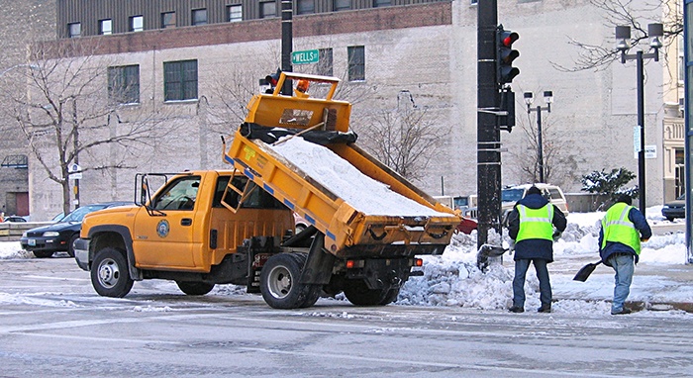
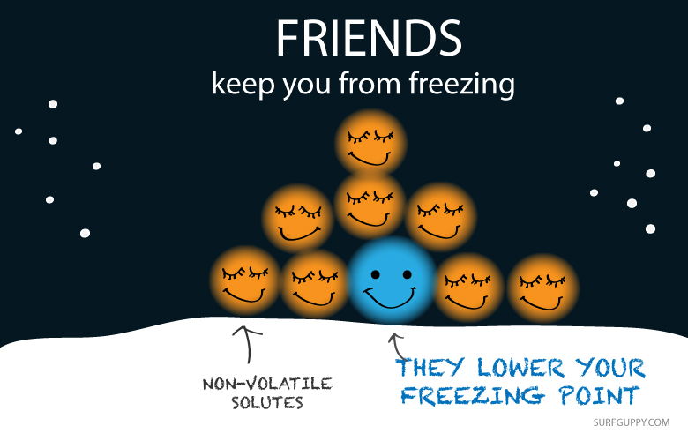
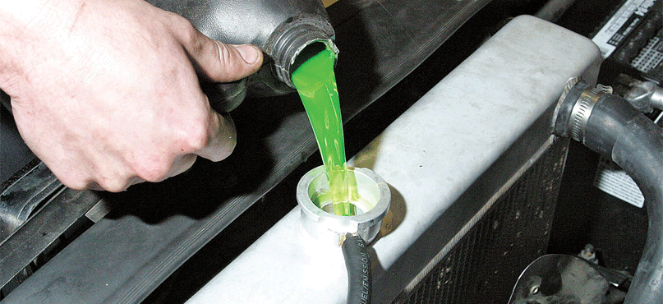
Freezing Point Depression

Slide 20
Freezing Point Depression
Addition of a nonvolatile solute to a solution lowers the freezing point of the solution relative to the pure solvent:
ΔT_{f} – the change in freezing/melting point (°C)
m – molality of the solution (mol/kg)
K_{f} – freezing point depression constant (°C/(mol/kg) or °C/m)
change in freezing temperature (ΔT_{b}) ∝ molality of the solution (m)
ΔT_{f} = K_{f}m
Note: the K_{f} value only depends on the solvent
the molality, m depends on the concentration of solute

Slide 21
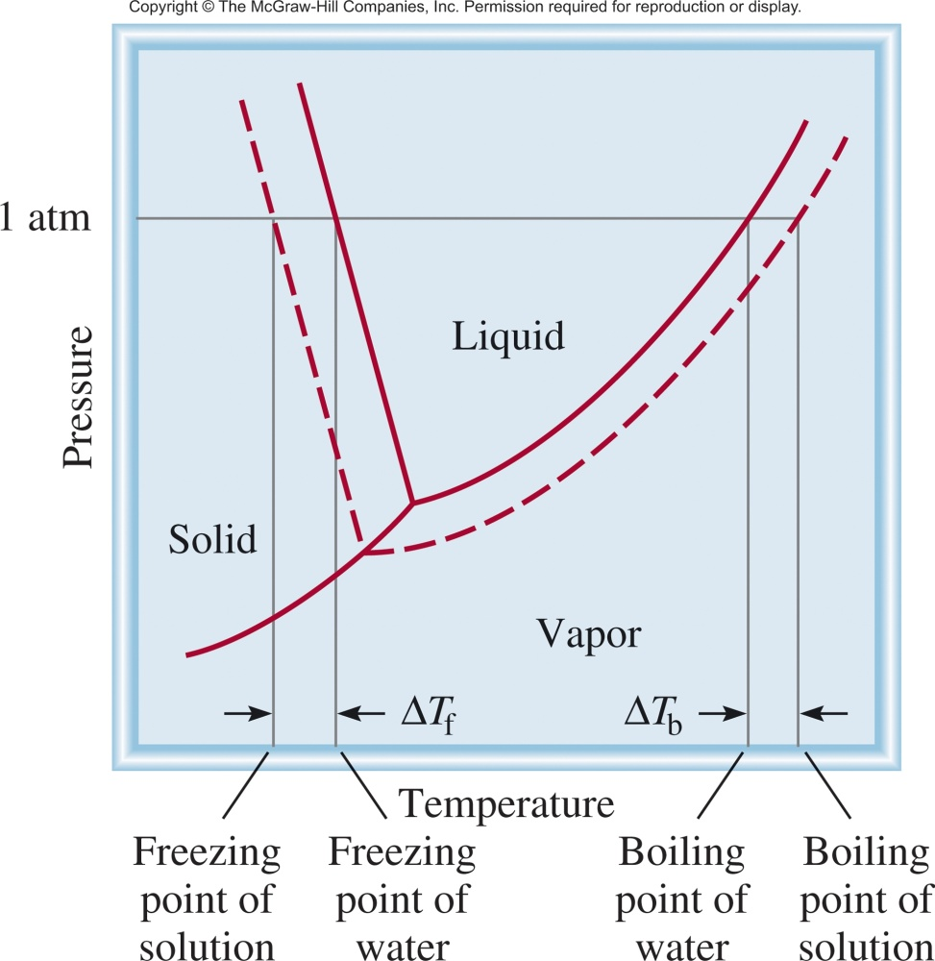
Phase Diagram Solution vs Water
Boiling point elevation
And
Vapor pressure lowering
Freezing point depression

Slide 22
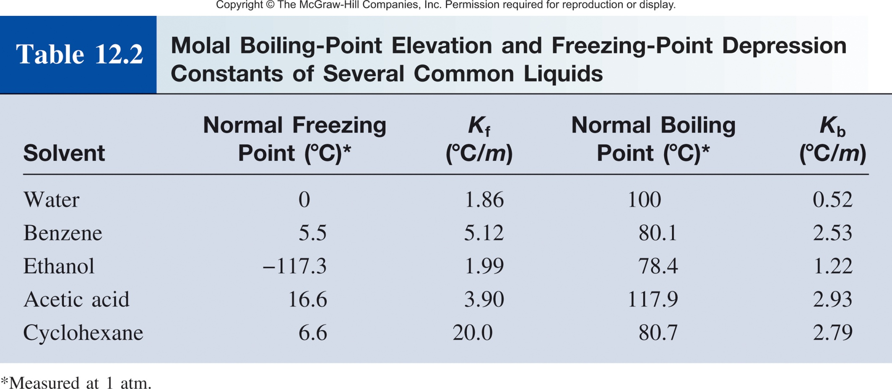
fp Depression and bp Elevation
ΔT_{f} = K_{f}m
ΔT_{b} = K_{b}m
ΔT_{f} – the change in freezing/melting point (°C)
m – molality of the solution (mol/kg)
K_{f} – freezing point depression constant (°C/(mol/kg) or °C/m)
ΔT_{b} – the change in boiling point (°C)
m – molality of the solution (mol/kg)
K_{b} – boiling point elevation constant (°C/(mol/kg) or °C/m)

Slide 23
Colligative Properties of Solutions
Solution- a homogenous mixture of two or more substances.
Solubility- the maximum amount of a solute that will dissolve in a given quantity of solvent at a specific temperature.
When solute is introduced into the volume of solvent, the solvent properties change
Colligative properties are properties of solutions that depend solely on the number of particles dissolved in the solution
Four types of colligative properties of solutions:
0
Vapor-Pressure Lowering
P₁ = X₁ P ₁
Boiling-Point Elevation
ΔT_{b} = K_{b} m
Freezing-Point Depression
ΔT_{f} = K_{f} m
Osmotic Pressure (π)
π = MRT

Slide 24
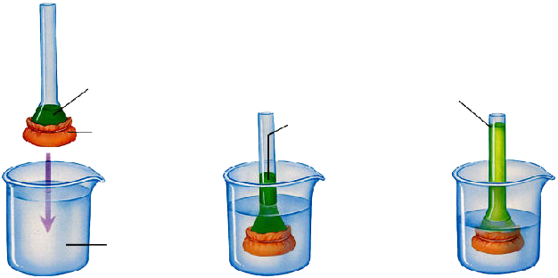
Osmosis
Osmosis is the selective passage of solvent molecules through a porous membrane from a dilute solution to a more concentrated one.
A semipermeable membrane allows the passage of solvent molecules but blocks the passage of solute molecules.
solution stops rising when weight of column equals osmotic pressure
3% salt solution
salt solution rising
selectively permeable membrane
distilled water

Slide 25
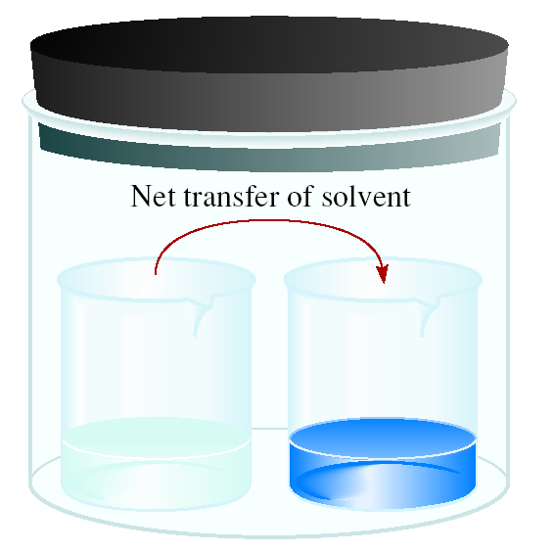
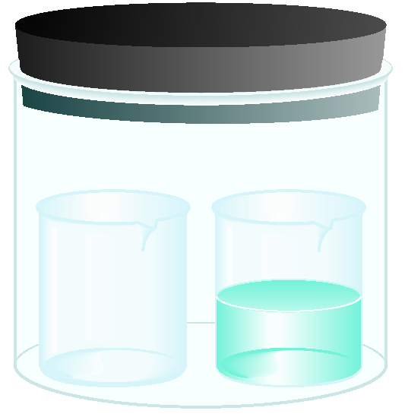

Alternative View
time
solvent
solution
High P
Low P
More out
than in
less out
than in
A semipermeable membrane allows the passage of solvent molecules but blocks the passage of solute molecules.

Slide 26
Osmosis
Osmosis is the selective passage of solvent molecules through a porous membrane from a dilute solution to a more concentrated one.
A semipermeable membrane allows the passage of solvent molecules but blocks the passage of solute molecules.
“Higher vapor pressure”
“Lower vapor pressure”
Osmotic pressure (π) is the pressure required to stop osmosis.

Slide 27
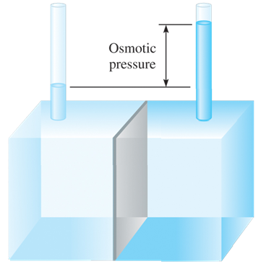
Osmotic Pressure
Osmosis is a rate controlled phenomenon.
The solvent is passing from the dilute solution into the concentrated solution at a faster rate than in opposite direction, i.e. establishing an equilibrium.
The osmotic pressure

Slide 28
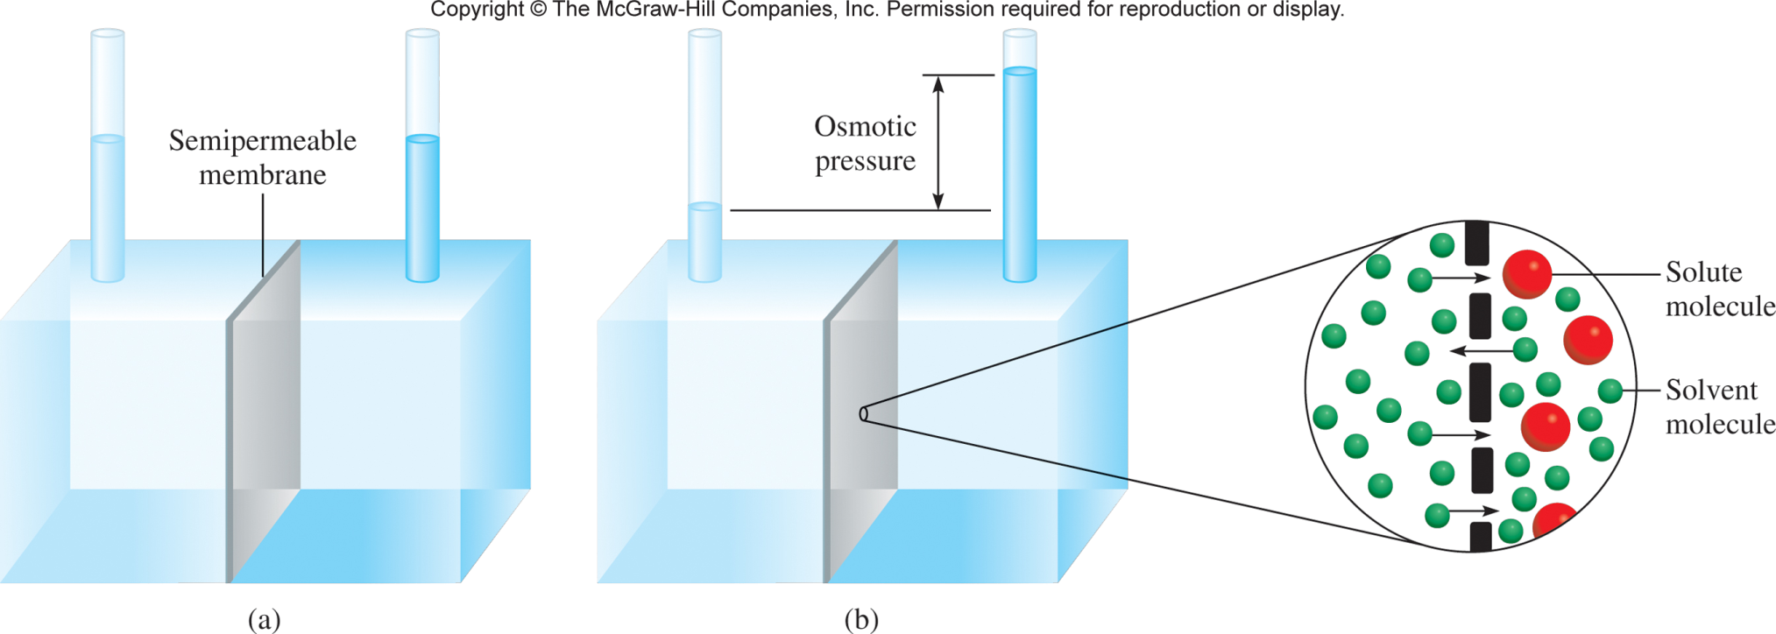
The average osmotic pressure of seawater, measured in the kind of apparatus shown below, is about 30.0 atm at 25°C. Calculate the molar concentration of an aqueous solution of sucrose (C₁₂H₂₂O₁₁) that is isotonic with seawater.

Slide 29
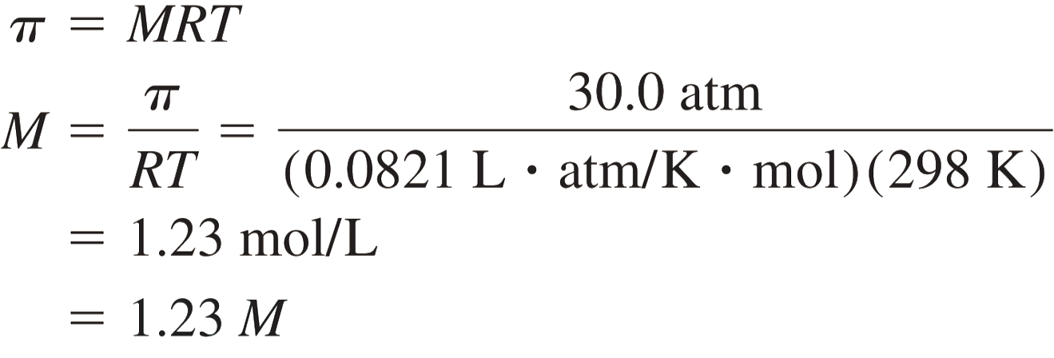
Strategy When we say the sucrose solution is isotonic with seawater, what can we conclude about the osmotic pressures of these two solutions?
Solution A solution of sucrose that is isotonic with seawater must have the same osmotic pressure, 30.0 atm. Using Equation (12.8).

Slide 30
A solution is prepared by dissolving 35.0 g of hemoglobin (Hb) in enough water to make up 1 L in volume. If the osmotic pressure of the solution is found to be 10.0 mmHg at 25°C, calculate the molar mass of hemoglobin.
We have π, R and T
Find M

Slide 31
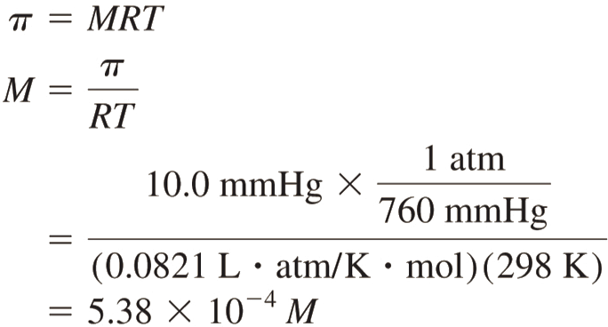
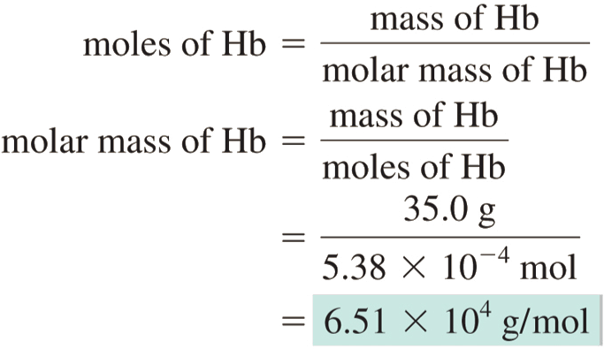
First we calculate the molarity:
The volume of the solution is 1 L, so it must contain 5.38 × 10⁻⁴ mol of Hb.
We use this quantity to calculate the molar mass:

Slide 32
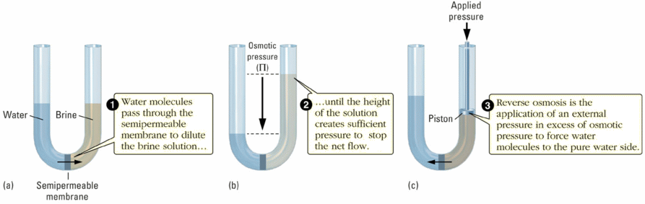
Reverse Osmosis
Used world-wide to purify sea water.
Ft. Myers, FL gets it drinking water from the Gulf of Mexico using reverse osmosis.
US Navy submarines do as well.
Dialysis is another example of this phenomenon.

Slide 33
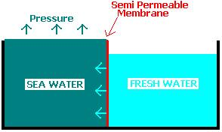
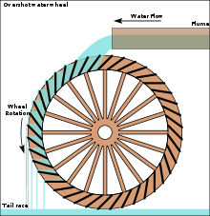
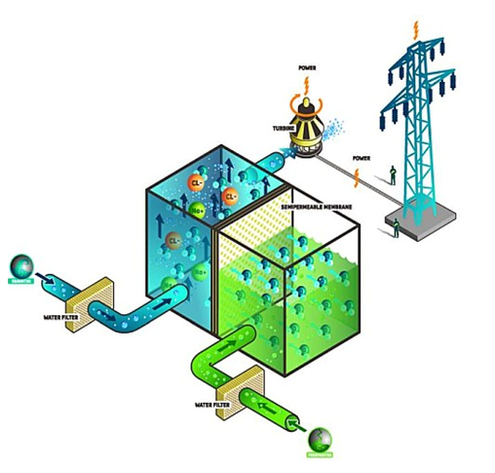

Generating Power with Osmosis
Salt Water
Fresh Water

Slide 34
Colligative Properties of Nonelectrolyte Solutions
Colligative properties are properties that depend only on the number of solute particles in solution.
0
Vapor-Pressure Lowering
P₁ = X₁ P ₁
Boiling-Point Elevation
ΔT_{b} = K_{b} m
Freezing-Point Depression
ΔT_{f} = K_{f} m
Osmotic Pressure (π)
π = MRT

Slide 35
Colligative Properties of Electrolyte Solutions
Colligative properties are properties that depend only on the number of solute particles in solution.
Sucrose
Dissolved
One particle
1 m
1 m
NaCl
Dissolved
Two particles
1 m
2 m
FeCl₃
Dissolved
Four particles
1 m
4 m
actual number of particles in soln after dissociation
van’t Hoff factor (i) =
number of formula units initially dissolved in soln

Slide 36
Colligative Properties of Electrolyte Solutions
Colligative properties are properties that depend only on the number of solute particles in solution.
actual number of particles in soln after dissociation
van’t Hoff factor (i) =
number of formula units initially dissolved in soln
Boiling-Point Elevation
ΔT_{b} = iK_{b} m
Freezing-Point Depression
ΔT_{f} = iK_{f} m
Osmotic Pressure (π)
π = iMRT

Slide 38
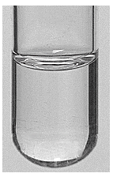
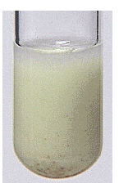
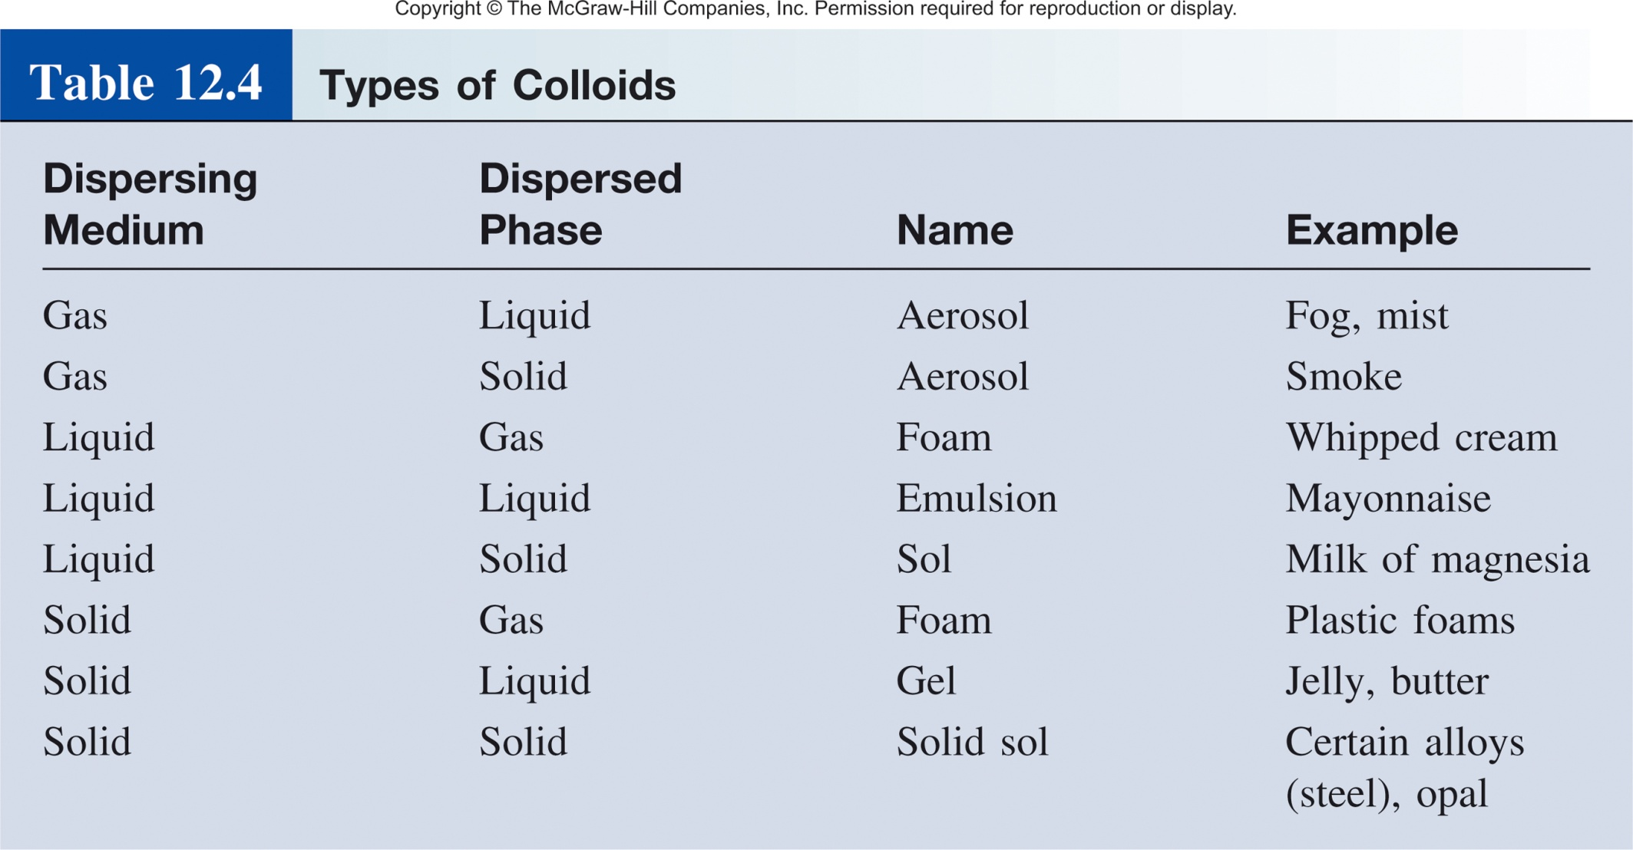
What if the “solute” doesn’t dissolve completely?
Solution
Homogeneous
Suspension
Heterogeneous
Colloids
1 to 1000 nm (10^{–9} to 10^{–6} m)

Slide 39
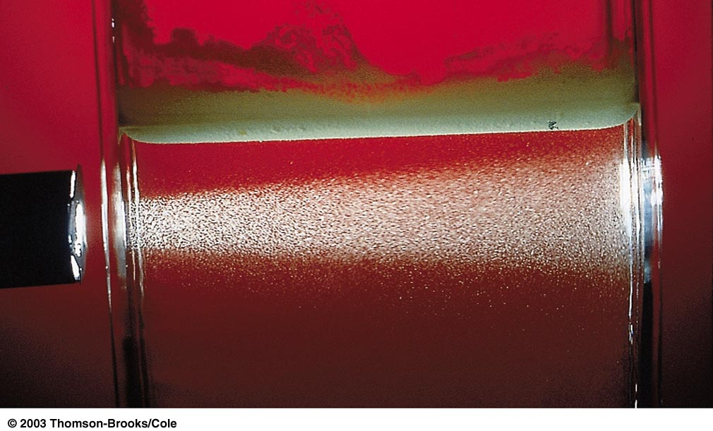


The Tyndall Effect
Colloids scatter light when it is shined upon them.
That’s why we see the sunlight scattered by dust.
This is also why we use low beams on cars when driving in fog.

Slide 40
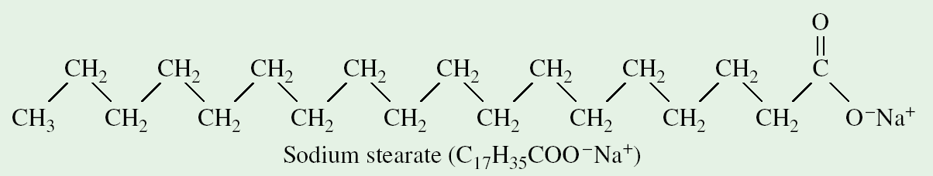
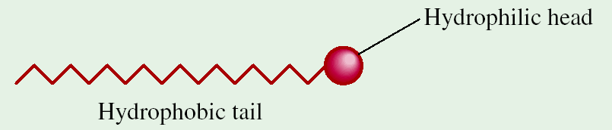
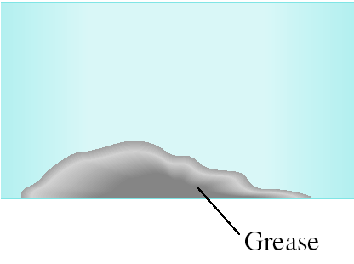
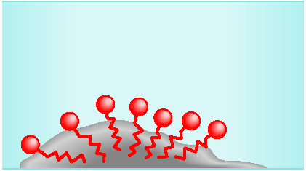
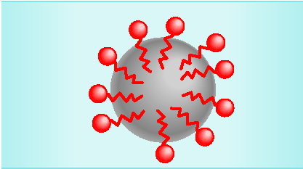
Soap and Colloids
Surfactants (surface-active agents) have a hydrophobic part and a hydrophilic part. Soaps and detergents are important examples:
Nonpolar
Polar
Water (polar)
Colloid
(nonpolar)

